Slide 1
Assignment 01 Web Canvas
Software Studio 軟體設計與實驗
Hung-Kuo Chu
Department of Computer Science
National Tsing Hua University
CS2410

Slide 2
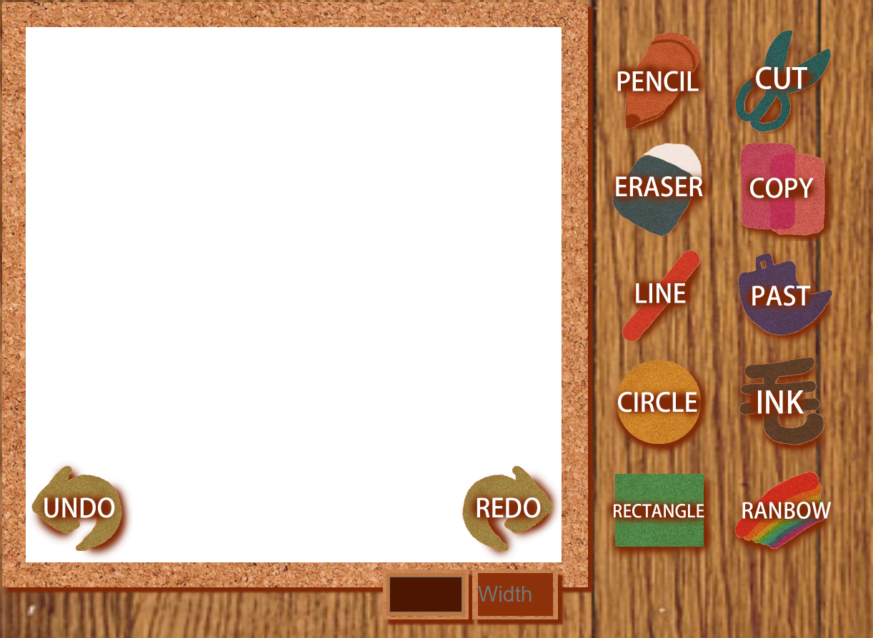
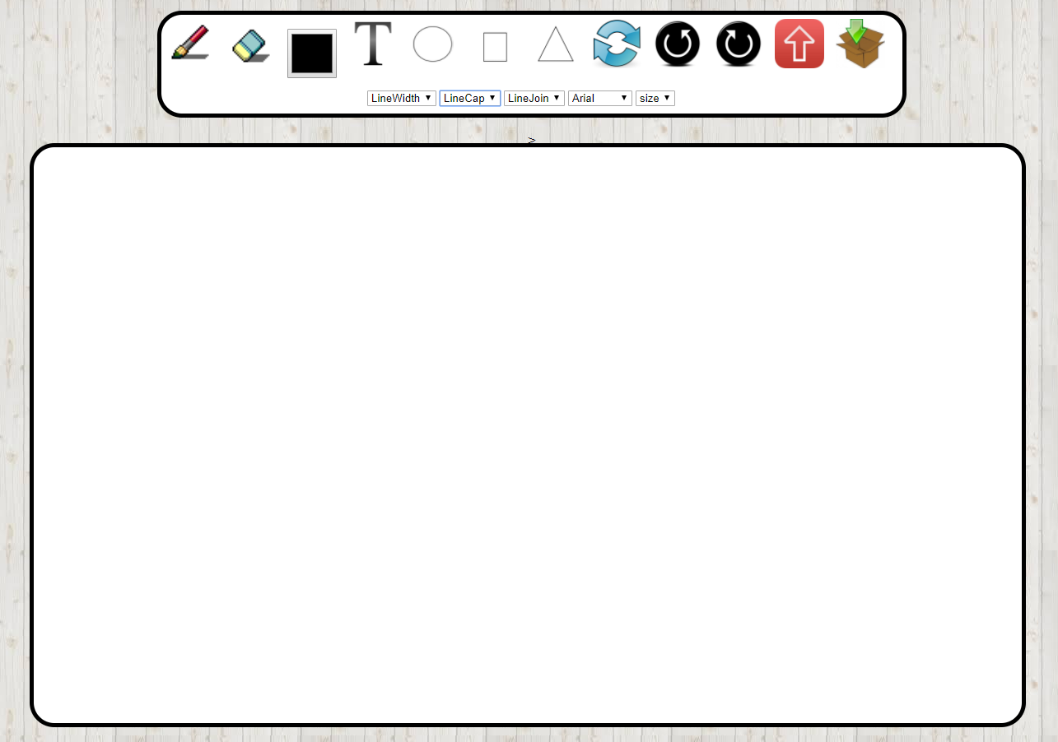
Web Canvas

Slide 3
Goal
Create your own web page with HTML5 canvas element where we can draw somethings.(HTML)
Beautify appearance (CSS).
Design user interaction widgets and control tools for custom setting or editing (JavaScript).
Describing the functions of your canvas in README.md by HackMD (you can reference the template by TAs)
You ought to explain how to operate your web, if TAs can’t find the function, you won’t get the points.

Slide 4
Basic components
Basic control tools (30%)
Brush and Eraser (You can not use white color as eraser!)
Color selector (<input type=“color”> is not acceptable)
Simple menu (brush size)
Text input (10%)
User can type texts on canvas
Font menu (typeface and size)
Cursor icon (10%)
The image should change according to the currently used tool
Refresh button (5%)
Reset canvas

Slide 5
Advanced tools
Different brush shapes (15%)
Circle, rectangle and triangle (5% for each shape)
Drag the cursor to make circles, rectangles, and triangles of different size (Please refer to the example)
Flickering canvas is not acceptable
Un/Re-do button (10%)
Image tool (5%)
User can upload image and paste it
Download (5%)
Download current canvas as an image file

Slide 6
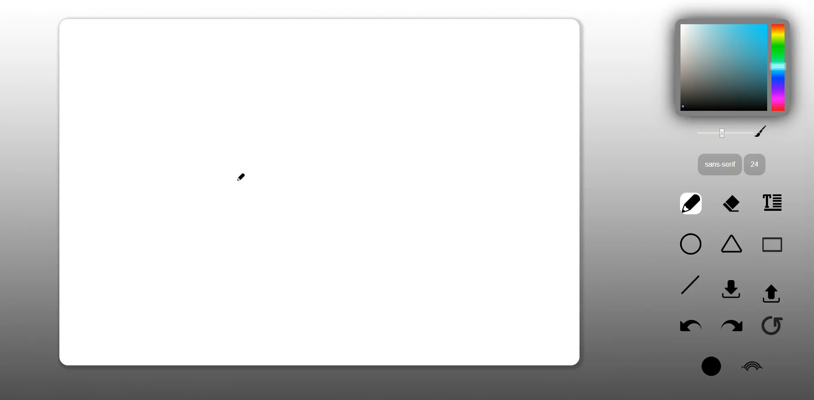
Basic Control Tools

Slide 7
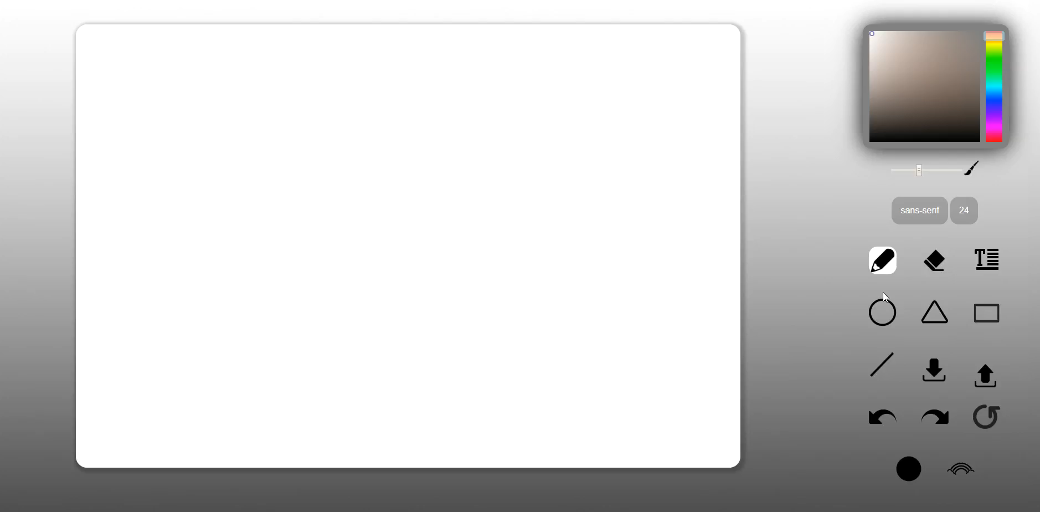
Text Input

Slide 8

Cursor Icon

Slide 9
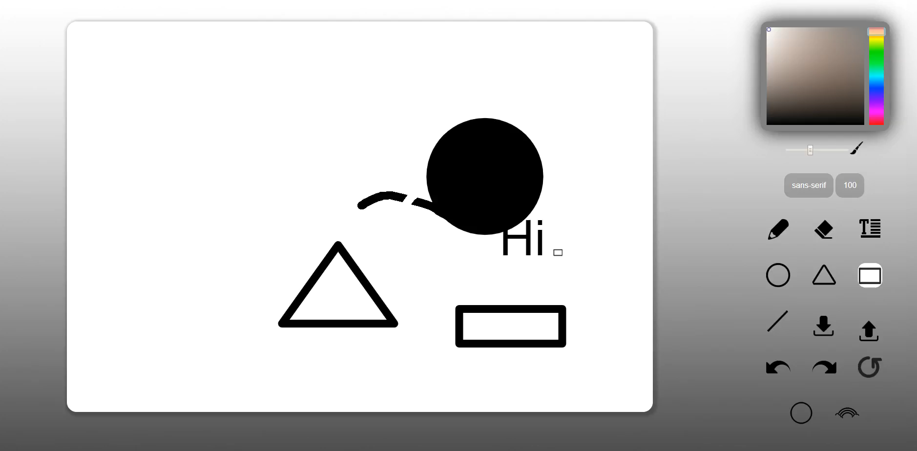
Refresh Button

Slide 10
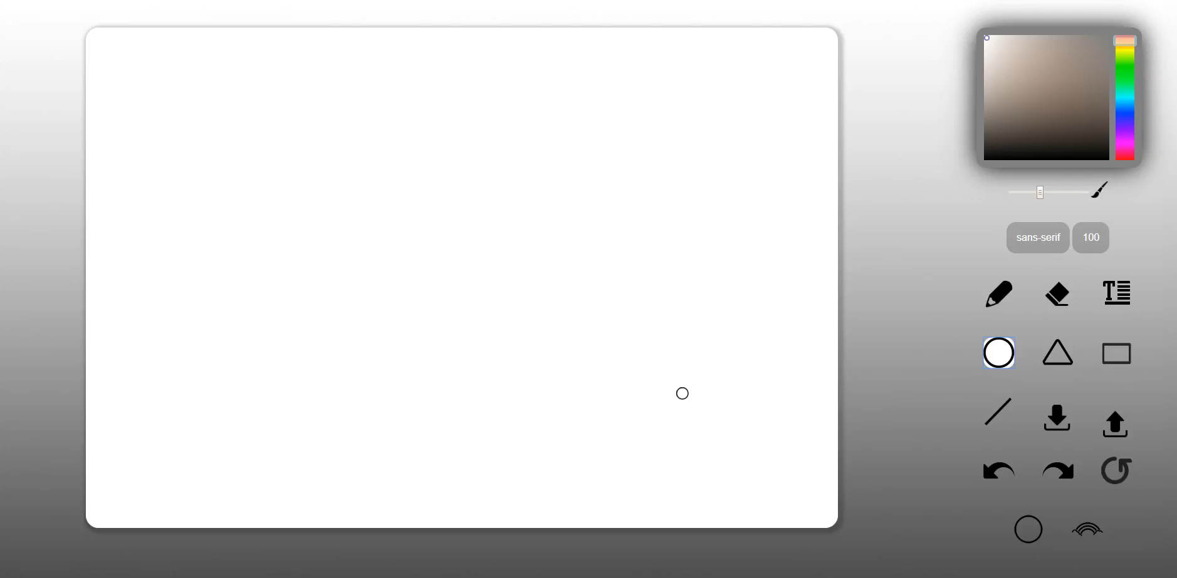
Different Brush Shape

Slide 11

Un/Re-do button

Slide 12

Image Tool

Slide 13

Download

Slide 14
All Functions

Slide 15
Scoring
Item | Score
Basic components | 55%
Advance tools | 35%
Appearance (subjective) | 10%
Other useful widgets (describe on README.md) | 1~5%

Slide 16
Reminder
Deploy your web page to Firebase page, and ensure it works correctly. Add TA’s account to your firebase project.
Your main page should be named as “index.html”
Upload all source code to FTP. (reference eeclass)
Compress all files into Assignment01_學號.zip then upload
index.html, .css, .js, README.md, etc.
source files
If you upload the files again, please change the filename become Assignment01_學號_v?.zip (v? -> which version)
MD5 checksum (if you didn’t do this → -10%)
FIRM deadline: 2023/03/30 23:59 (commit time)
Upload your MD5 and web link to eeclass

Slide 17
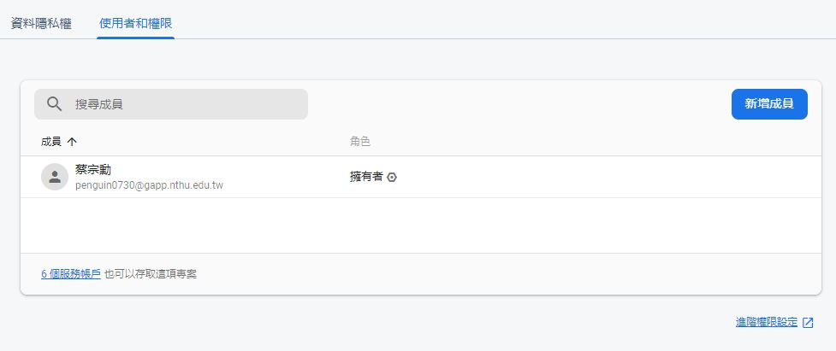
Add permission to TA’s account
Go project setting and select “Users and permissions”

Slide 18
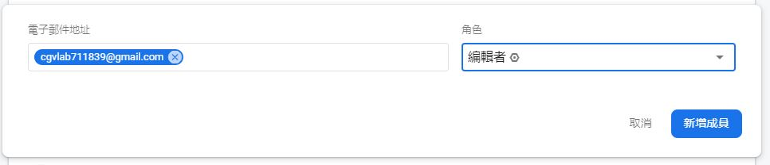
Add permission to TA’s account
Add cgvlab711839@gmail.com as editor to your project.

Slide 19
作業規則
程式碼嚴禁抄襲，抓到抄襲者，抄襲與被抄襲者
直接當掉！直接當掉！直接當掉！
直接當掉！直接當掉！直接當掉！
…
繳交期限為兩個星期，不得遲交。
沒有屍體分數，遲交零分且不得補交。
Notes:
2021 抄襲改成直接當掉

Slide 20
作業繳交規則
請務必透過 MD5 獲得作業checksum 後填入 google 表單。
如遇各種原因無法在作業期限前完成上傳，我們將比對 checksum。若 checksum 一致則不算遲交。
繳交作業以MD5為主，若有多個 checksum 則取時間最晚的為主。
MD5 online generator
MD5 checksum 登記表單
MD5 checksum 登記查看
MD5 使用方法

Slide 21
作業繳交流程
請務必遵守以下規則：
將作業打包壓成zip檔，檔名格式以及打包內容以當次作業公告為主。
幫zip檔產生MD5，並填寫google表單。
將zip檔上傳ftp。
將MD5和網址繳交至eeclass。
若違反任何一項繳交作業SOP，
一律扣作業總分10分！！！
貼心提醒：請同學守護zip檔至作業成績公告或期末。
Notes:
2021 新增作業繳交流程

